Slide 1
Web Programming: Team #5
</
/>
Keidra Floyd,Shubhang Arashanapalli, Ulyssies Adams, Junghyun Kim

Slide 2
</Team Assignments
Keidra Floyd
Leader/Designer
Shubhang Arashanapalli
Coder/Programmer
Team Breakdown
Ulyssies Adams
Tester/User Representative
Junghyun Kim
Code/Programmer

Slide 3
</Project Breakdown
For our project we decided on option three which is the interactive board game using html and css.
The board game we ended up choosing was an all time family favorite, Scrabble. Scrabble is a word game where players use letter tiles to create intersecting words on a board, aiming to score points through strategic placement and high-value letters. It's a blend of language proficiency and strategic thinking.

Slide 4
</Kanban Methodology
Throughout the creation of our project we used the Kanban Methodology to help with the work distribution and organization of our project.
We divided the work into parts and would convene via discord calls to update how our portion of the project was going and to see how everyone else was doing on their part.
We also used text channels for any concerns or updates to the project that happened outside of the calls that we would have and would assist the other members on parts of the project that they couldn’t figure out or were struggling with.

Slide 5
</Project Goals
Some of the goals we wanted to achieve with this project are:
Interactive User Interface: we wanted to have a compelling UI that was both pleasing to look at and user friendly.
Animated Sequences: having animation in our project was something we focused on because it helps bring the project to life and is more dynamic for the user experience.
True to the Original: we wanted to stick to the original game model because it is timeless and a classic that has been popular for decades, if it’s not broke don’t fix it.
Accessibility: one of our main goals was to create something anyone no matter the age or technological experience could just pick up and play, we did this by keeping it simple and as true to the original game as possible when creating our vision

Slide 6
</User Requirements
User-Input
Like the original game, players are given letter tiles and expected to create words for points.
Each letter is given a point value, users are to put a letter tile on the board and create words from the tiles that they have left
Expected-Output
When a word is created, the system is to respond by assigning points to the user based on the word that is created,
Bonus tiles are to act as multipliers like the original game and will greatly increase the amount of points if done right.

Slide 7
</Design Overview
Key Design Features-
We used a typical 15x15 scrabble board as the foundation of our project, we wanted to stay as accurate to the board game as possible throughout the entirety of the development period.
HTML was used to make the individual rows filled with the normal and specialty tiles
CSS was used to make the proportions fit better on users screens and also with some of the transformations/animations present in the gameboard

Slide 8
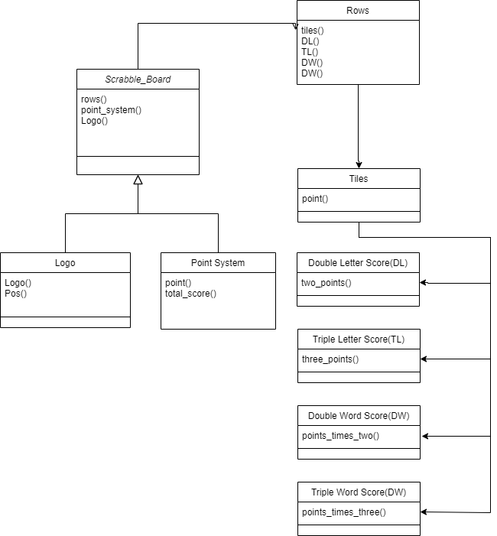
</Design Overview - UML Diagram

Slide 9
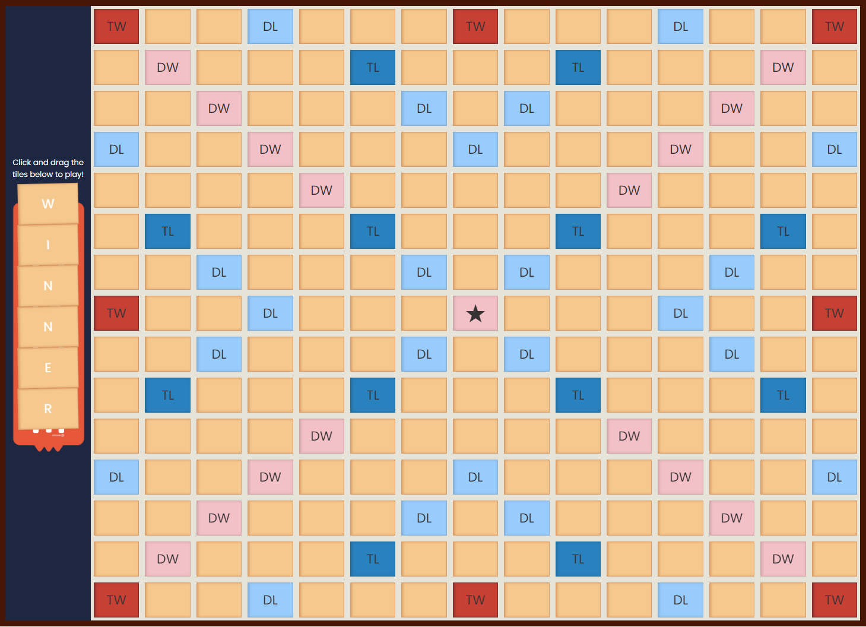
</Board Game Preview

Slide 10
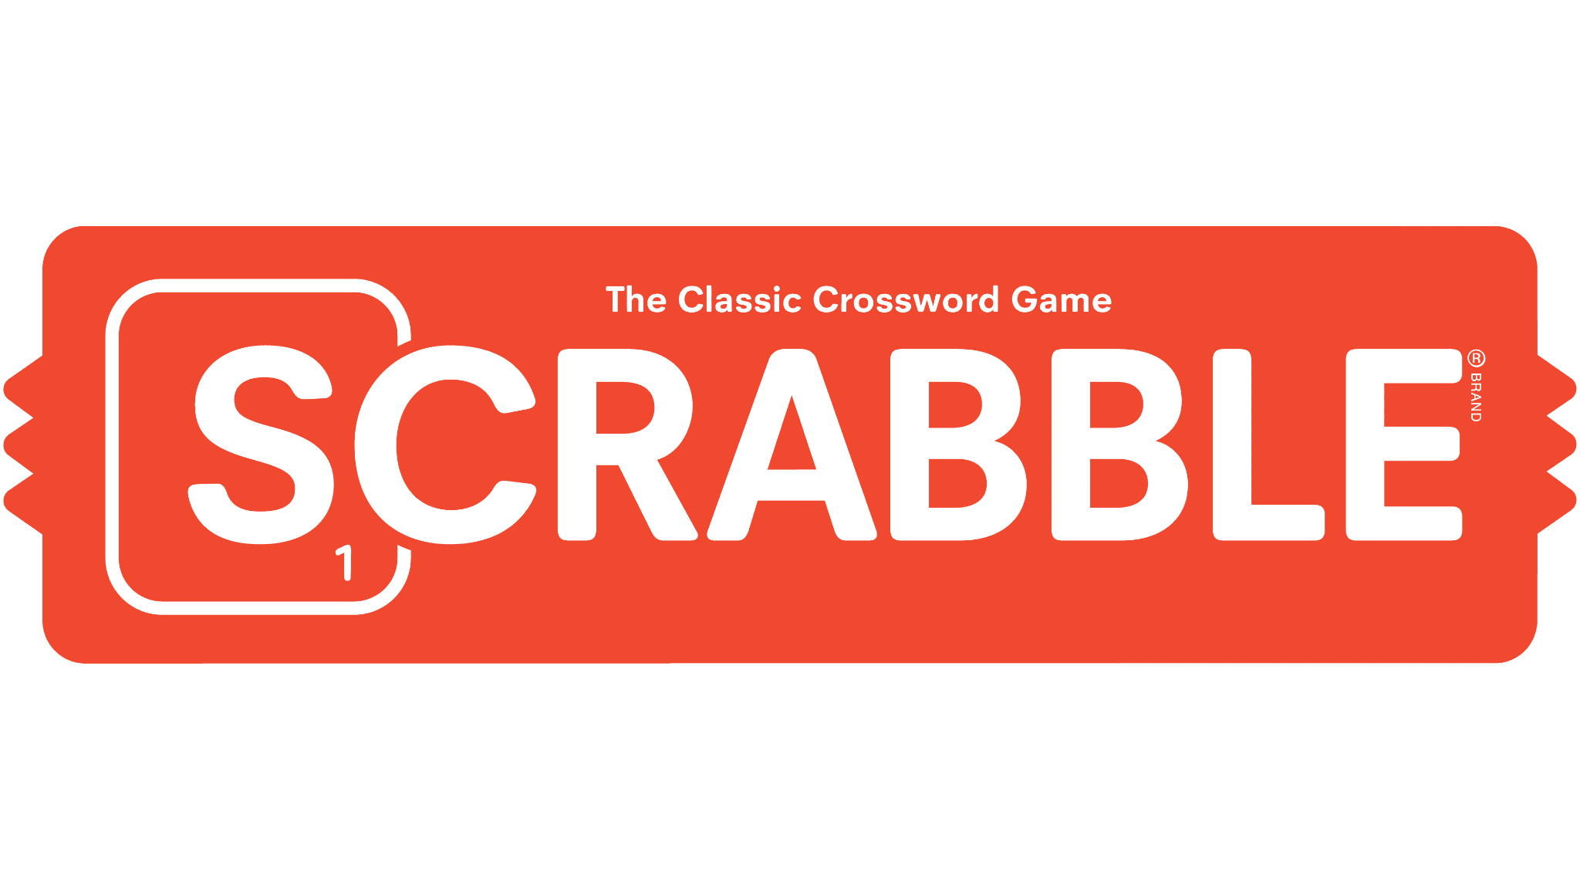
</Technologies Used
{HTML}
{CSS}
{Images}

Slide 11
</Code Breakdown
HTML
We used HTML to create the entirety of the Scrabble board and solidify the structure of our gameboard
CSS
CSS was used to make the board look better put together and also with the transformations and animations
{90%}
{10%}

Slide 12
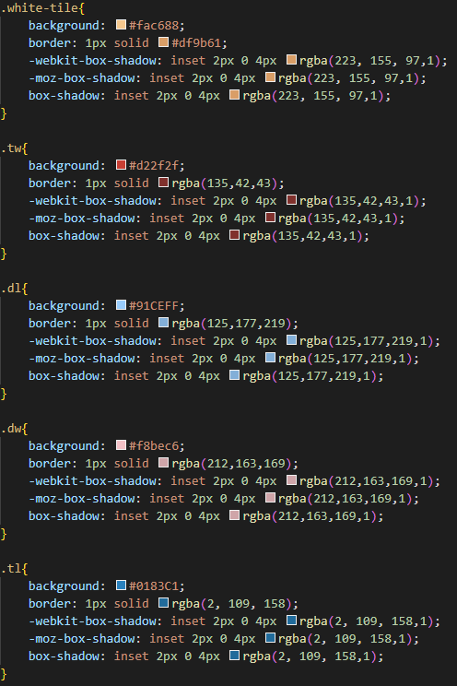
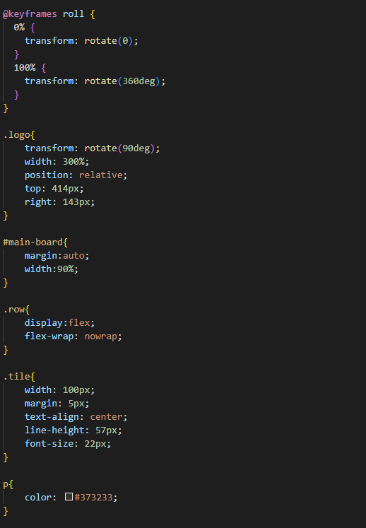
</CSS Overview
<-
This portion of the CSS code shows how the individual tiles were styled, each class would then be used in the css code to make the tiles unique and look different from one another
->
This portion of the CSS code shows the transformations and proportioning that we used to make the board game look pleasing to the eye and organized.

Slide 13
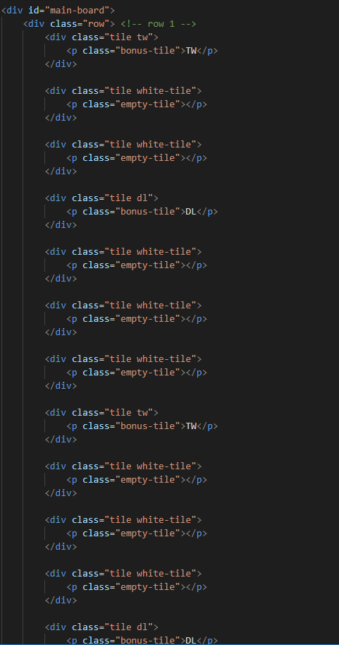
</HTML Overview
This code showcases the first row of the Scrabble board, it breaks down the pattern of specialty tiles and normal tiles that would be followed in the other 14 rows that comprised the rest of the game.

Slide 14
Thank You!

